Slide 1


KE-EXPO CROP RECOMMENDER
Predicting ideal crops and identifying factors that enhance export success.
HTTPS://BRC0D3S.SHINYAPPS.IO/KE-CASHCROPRECOMMENDATION/

Slide 2
Overview
Developed a system to map environmental conditions of Kenyan cash crops to appropriate recommendations.
Created a robust machine-learning model to classify crops based on factors like temperature, rainfall, humidity, and soil pH.
Built an interactive Shiny Dashboard for user-friendly interaction with the model.

Slide 3
Data Preparation
Imported and cleaned data from a CSV file containing crop and environmental details.
Mapped global crops to Kenyan export crops based on climatic and soil conditions.
Exported the updated dataset for further analysis.

Slide 4
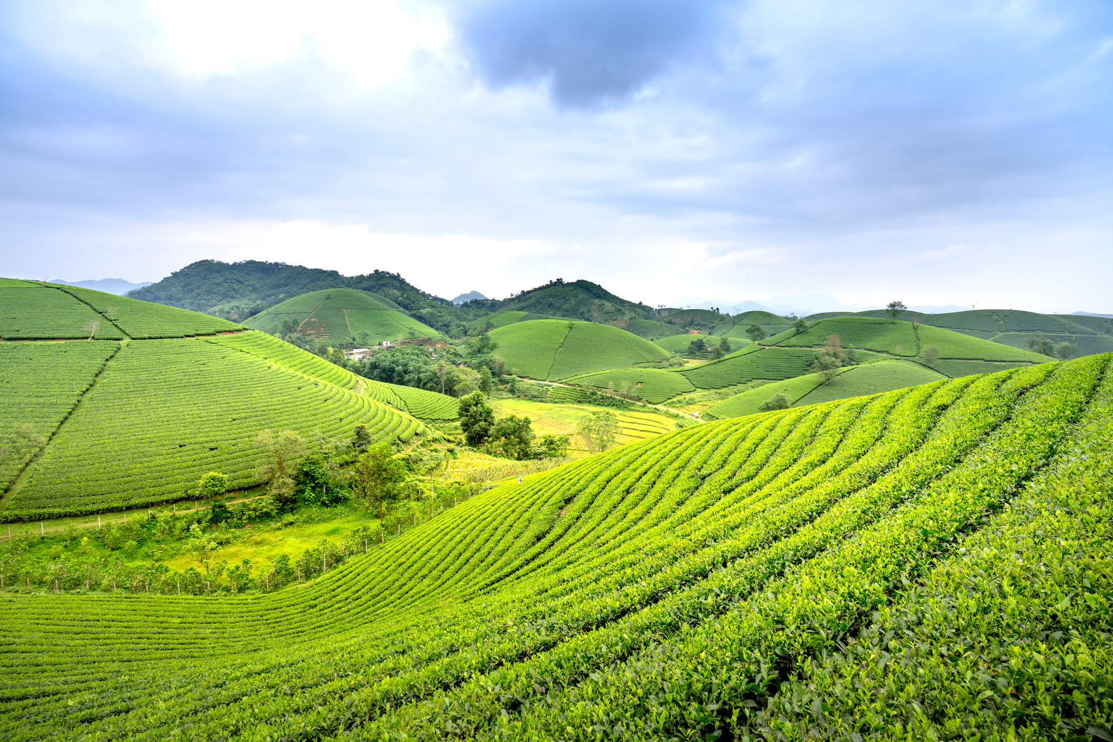
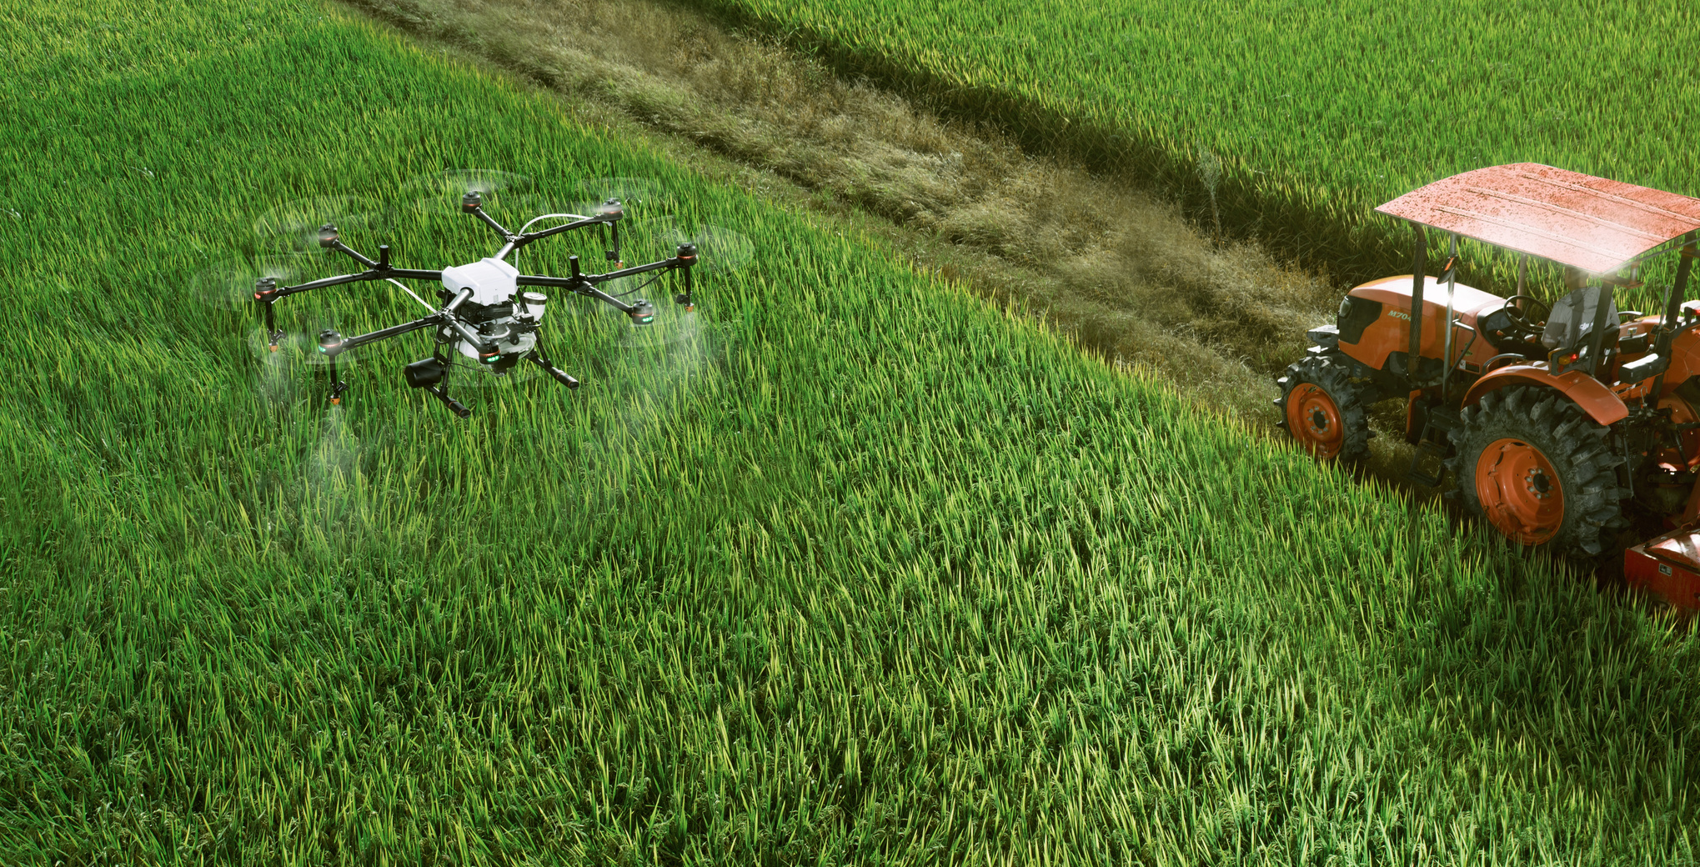
Data Cleaning
Performed data cleaning:
Handled missing and duplicate values.
Verified and encoded crop labels.

Slide 5
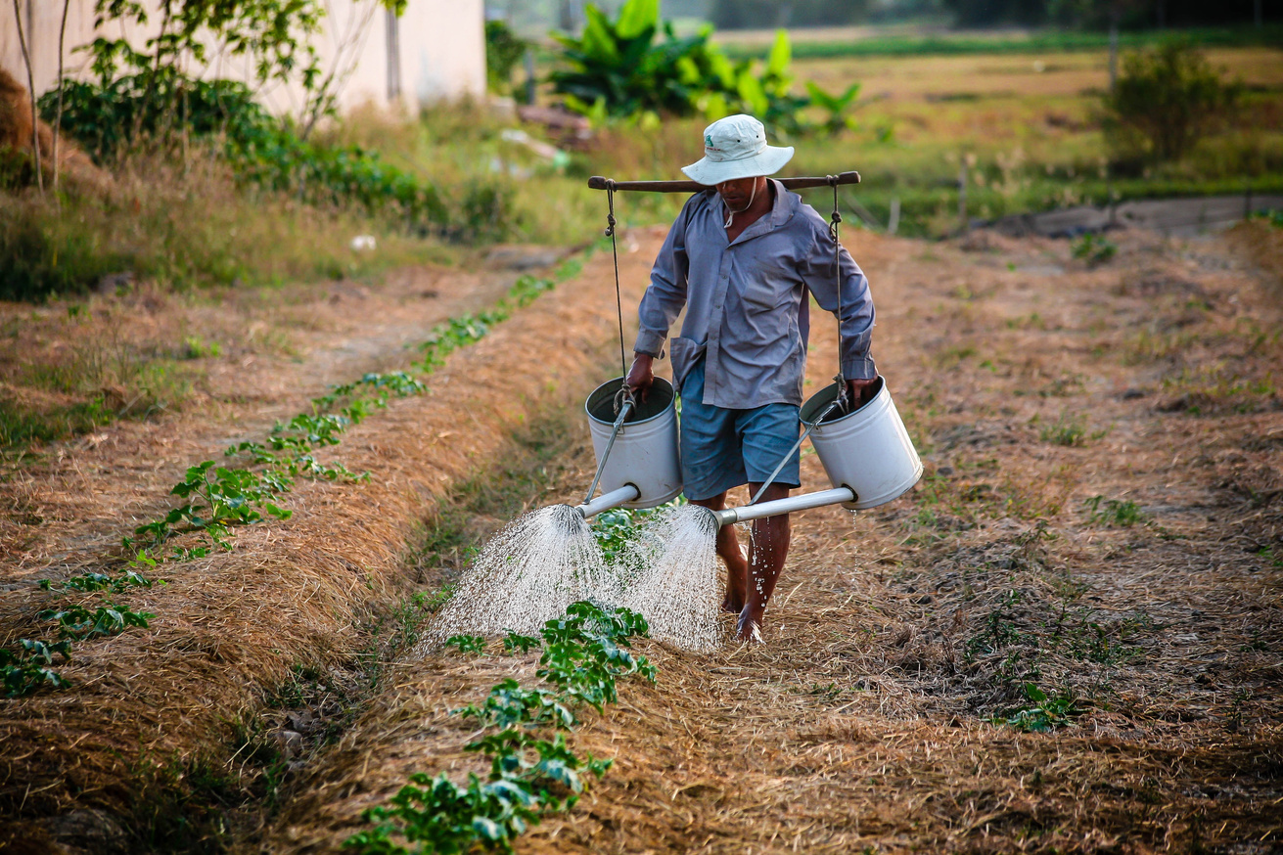
Data Visualiztion
Bar charts for crop counts.
Scatter plots for environmental factors like rainfall vs. humidity.
Box plots for temperature ranges per crop.
Histograms for soil pH distribution.

Slide 6

Machine Learning Pipeline
Trained multiple models:
Random Forest, SVM, Decision Tree, Naive Bayes, KNN, and Multinomial Logistic Regression.
Evaluated models using accuracy and selected the best-performing Random Forest model.
Built a predictive function to recommend crops based on user-input environmental parameters.

Slide 7
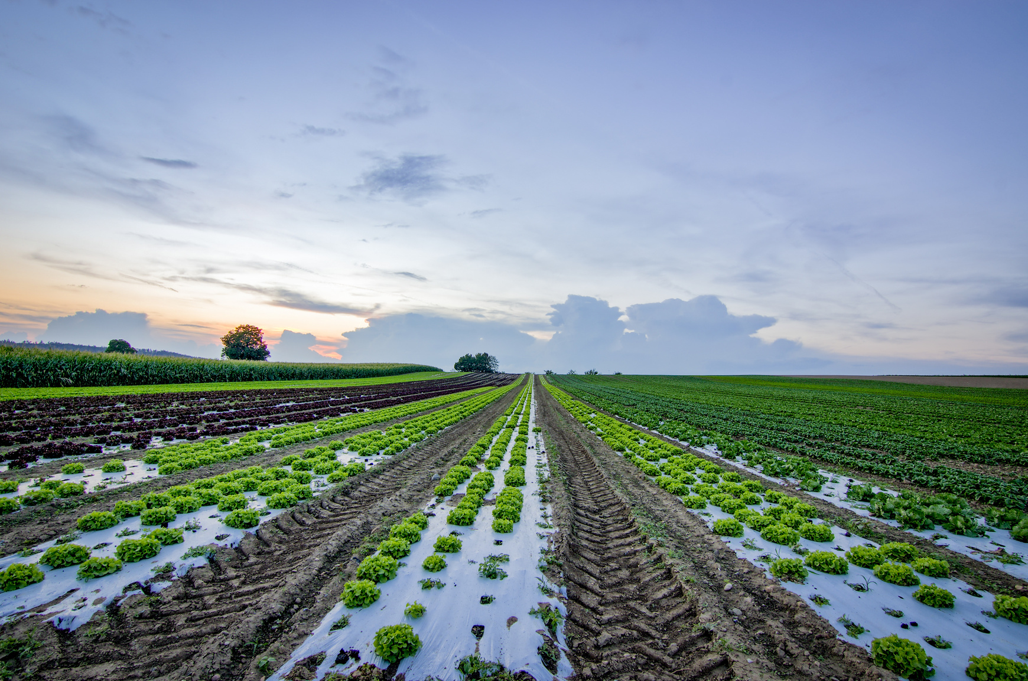
Shiny Dashboard
Designed a Shiny Dashboard to enable users to interact with the model seamlessly.
Features include:
Input Form: Allows users to provide parameters like nitrogen, phosphorus, potassium (NPK), temperature, rainfall, humidity, and pH.
Dynamic Recommendations: Displays the most suitable Kenyan cash crop based on the entered conditions.

Slide 8
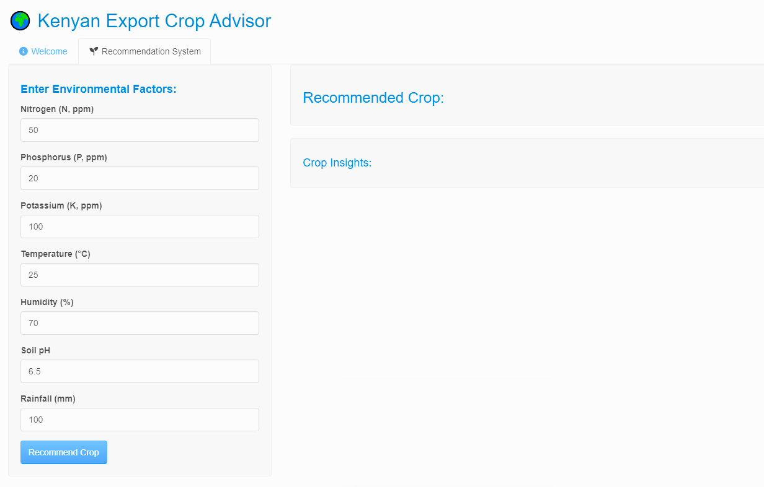
System Protype

